Slide 1
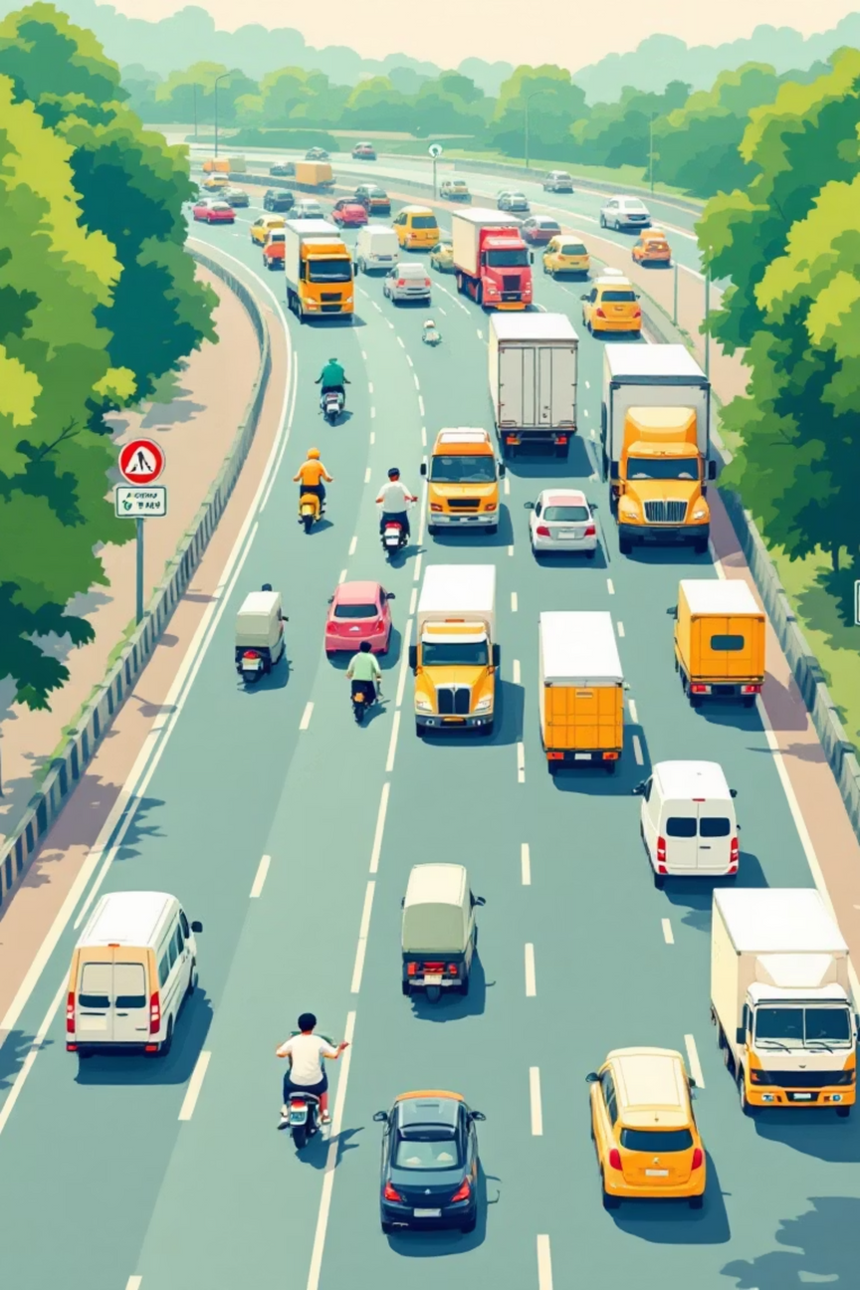

Road Accident Analysis in India
Presenter: Saloni Singh | Institution: Invertis University
Notes:
1

Slide 2
Project Objective
Purpose
Goal
This analysis examines road accident data across India to uncover critical patterns and trends that contribute to traffic incidents. By identifying key factors, we aim to provide data-driven insights for policy makers and safety officials.
To support evidence-based safety improvements through comprehensive analysis of accident causes, driver demographics, and environmental conditions. The findings can inform targeted interventions and awareness campaigns.
Notes:
2

Slide 3




Technology Stack: Power BI
Data Cleaning & Transformation
Interactive Visualization
Chart Generation
Built dynamic dashboards enabling stakeholders to explore data through filters and drill-down capabilities.
Created comprehensive visual analytics to identify trends, patterns, and correlations across accident variables.
Streamlined raw data from multiple sources, ensuring consistency and accuracy for reliable analysis.
Notes:
3

Slide 4

Dataset Overview
Data Source
Key Attributes
Platform: Kaggle
Accident frequency and count
Format: Structured dataset
Road surface classification
Geographic Focus: India
Driver demographics and experience
Vehicle-driver relationships
Accident causation factors
Notes:
4

Slide 5
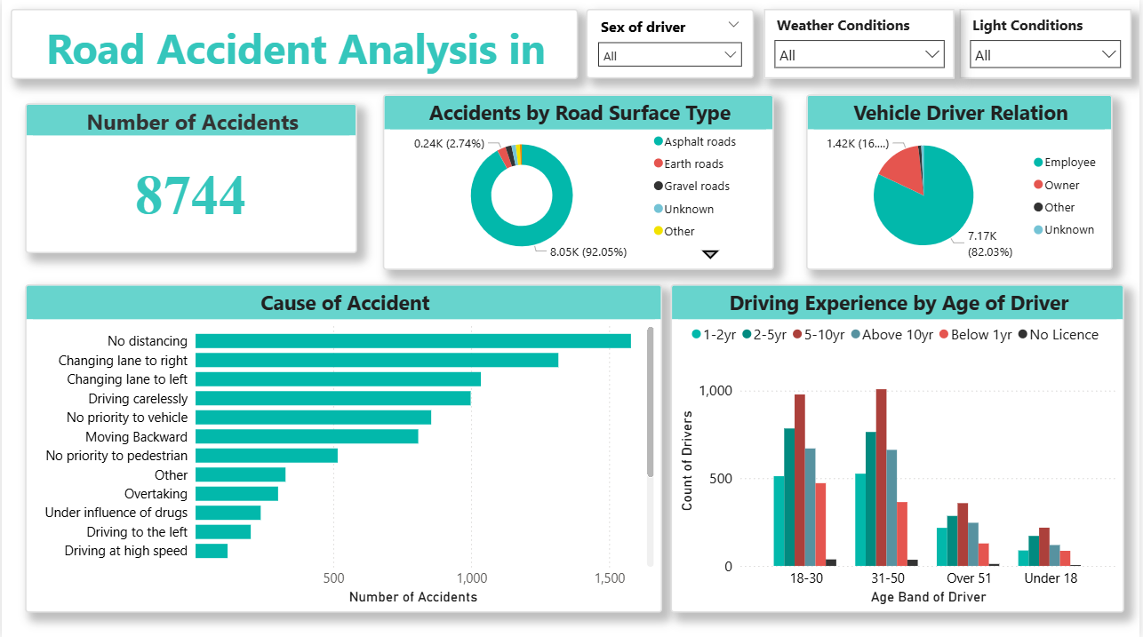
Power BI Dashboard
Notes:
5

Slide 6





Key Statistics
12.4K
68%
55%
31-50
Total Recorded Accidents
Asphalt Road Dominance
Employee Drivers
Highest Risk Demographics
Comprehensive database of documented incidents
Majority of accidents on paved surfaces
Primary driver category in dataset
Drivers in this age bracket, typically with 2-10 years of experience, show elevated accident rates
Notes:
6

Slide 7



Primary Accident Causes
No Distancing
Lane Changing
Speed Violations
Insufficient following distance between vehicles emerges as the leading cause, particularly in high-density traffic areas.
Improper or aggressive lane changes without adequate signaling contribute significantly to collision incidents.
Excessive speed and failure to adjust velocity to road conditions remain critical risk factors.
Notes:
7

Slide 8
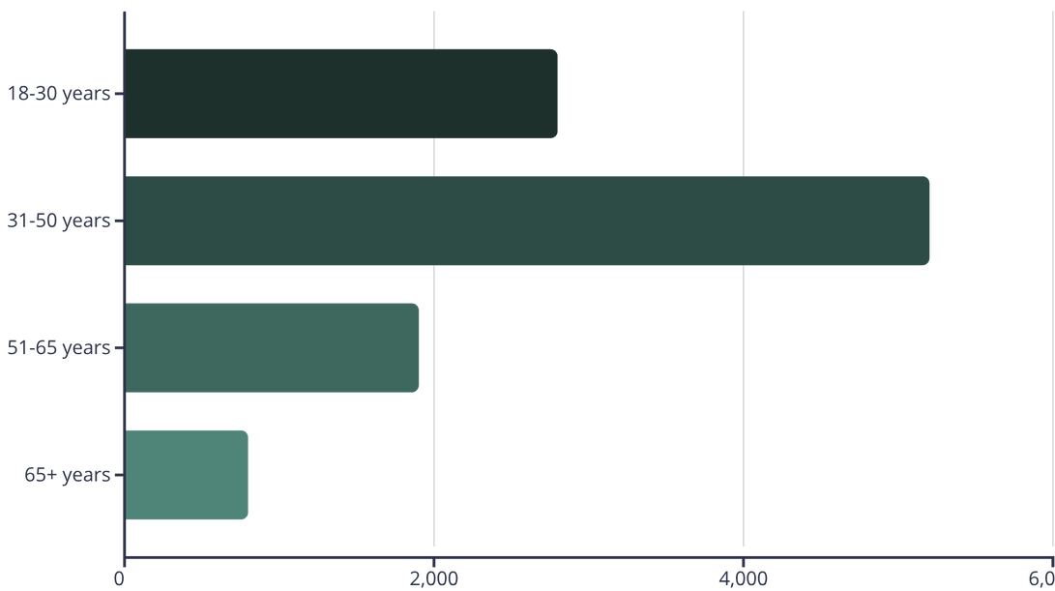
Driver Age Group Analysis
Critical Finding
The 31–50 age group shows the highest accident involvement, representing over 48% of all incidents analyzed.
This demographic likely combines high exposure (daily commuting) with potential risk-taking behaviors and distractions.
Notes:
8

Slide 9

Driving Experience Insights
1
0-2 Years
1,200 accidents - New drivers still developing skills
2
2-10 Years
6,500 accidents - Highest risk group showing overconfidence
3
10-20 Years
2,800 accidents - Moderate experience, declining incidents
4
20+ Years
900 accidents - Lowest rates with mature driving habits
Drivers with 2–10 years of experience represent the critical intervention zone, where confidence may exceed actual skill level, leading to higher accident rates.
Notes:
9

Slide 10




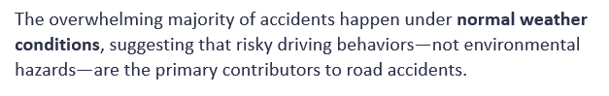
Environmental Conditions Analysis
Light Conditions
Weather Conditions
71%
82%
Daylight Accidents
Normal Weather
29%
18%
Dark/Dawn/Dusk
Adverse Weather
Most accidents occur during daylight hours despite optimal visibility, indicating that driver behavior and traffic density are more significant factors than lighting conditions.
The overwhelming majority of accidents happen under normal weather conditions, suggesting that risky driving behaviors—not environmental hazards—are the primary contributors to road accidents
Notes:
10

Slide 11

Conclusions and Implications
Behavioral Patterns
Vulnerable Populations
Infrastructure Considerations
Data reveals systematic factors and poor driving practices as primary accident drivers.
Specific demographic groups require targeted intervention and safety awareness initiatives.
Road surface type correlations suggest opportunities for infrastructure improvements and maintenance.
Notes:
11

